Slide 1
SIMPLE INTEREST

Slide 2
Simple Interest Formula :
The formula for simple interest helps you find the interest amount if the principal amount, rate of interest and time periods are given.
Simple interest formula is given as:
SI=PTR/100
Where SI = simple interest
P = principal
R = interest rate (in percentage)
T = time duration (in years)

Slide 3
Amount (A) = Principal (P) + Interest (I)
Where,
Amount (A) is the total money paid back at the end of the time period for which it was borrowed.
The total amount formula in case of simple interest can also be written as:
A = P(1 + RT)
Here,
A = Total amount after the given time period
P = Principal amount or the initial loan amount
R = Rate of interest (per annum)
T = Time (in years)

Slide 4
SIMPLE INTEREST
Q.1: A sum of 4000 is lent for 5 years at the rate of 15% per annum. Find the interest.
(1) 3000 (2) 2000 (3) 1000 (4) 1500 (5) None of these

Slide 5
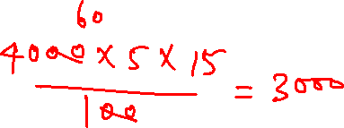
SIMPLE INTEREST
Q.1: A sum of 4000 is lent for 5 years at the rate of 15% per annum. Find the interest.
(1) 3000 (2) 2000 (3) 1000 (4) 1500 (5) None of these

Slide 6
SIMPLE INTEREST
Q.2: If the simple interest on 625 increases by 25, when the time increases by 2 years. Find the rate per cent per annum.
(1) 2% (2) 3% (3) 1% (4) 0.5% (5) None of these

Slide 7

SIMPLE INTEREST
Q.2: If the simple interest on 625 increases by 25, when the time increases by 2 years. Find the rate per cent per annum.
(1) 2% (2) 3% (3) 1% (4) 0.5% (5) None of these

Slide 8
SIMPLE INTEREST
Q.3: A man deposits 1350 in a bank at 5% per annum and 1150 in another bank at 6% per annum. Find the rate of interest for the whole sum.
5.40% (2) 6.40% (3) 5.46% (4) 115%
(5) None of these

Slide 9
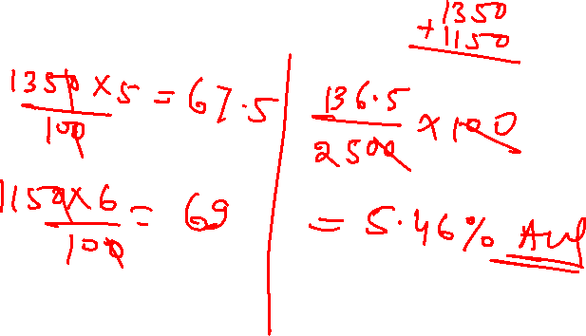
SIMPLE INTEREST
Q.3: A man deposits 1350 in a bank at 5% per annum and 1150 in another bank at 6% per annum. Find the rate of interest for the whole sum.
5.40% (2) 6.40% (3) 5.46% (4) 115%
(5) None of these

Slide 10
SIMPLE INTEREST
Q.4: The simple interest on a sum of money is 4/9 of the principal, and the number of years is equal to the rate per cent per annum. Find the rate per cent.
6(2/3)% (2) 5(3/5)% (3) 7(2/3)% (4) 6(1/3)% (5) None of these

Slide 11
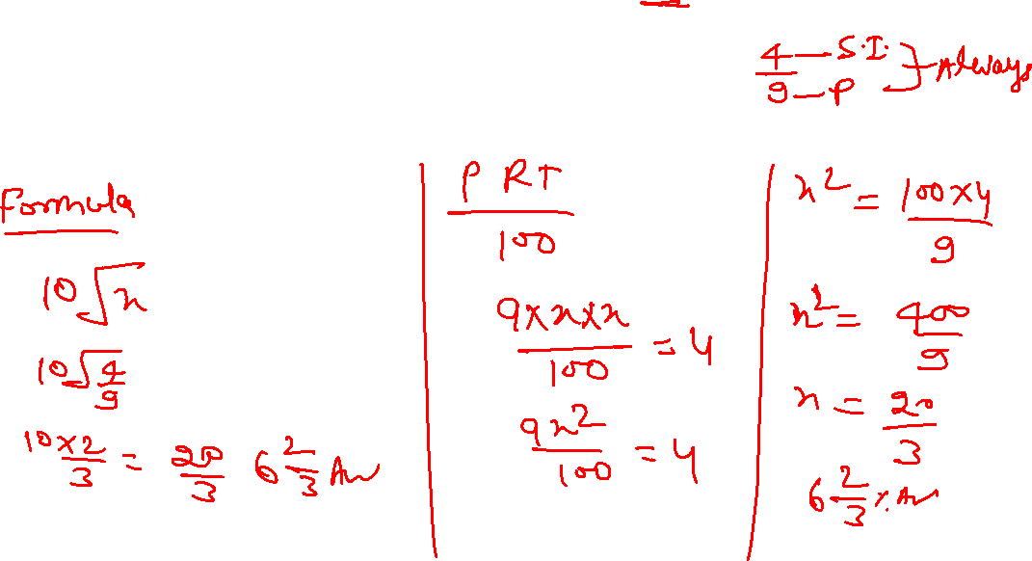
SIMPLE INTEREST
Q.4: The simple interest on a sum of money is 4/9 of the principal, and the number of years is equal to the rate per cent per annum. Find the rate per cent.
6(2/3)% (2) 5(3/5)% (3) 7(2/3)% (4) 6(1/3)% (5) None of these

Slide 12
SIMPLE INTEREST
Q.5: If the simple interest on 1350 be more than the interest on 1250 by 20 in 2 years, find the rate per cent per annum.
(1) 5% (2) 10% (3) 6% (4) 8% (5) None of these

Slide 13
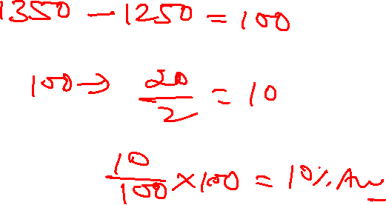
SIMPLE INTEREST
Q.5: If the simple interest on 1350 be more than the interest on 1250 by 20 in 2 years, find the rate per cent per annum.
(1) 5% (2) 10% (3) 6% (4) 8% (5) None of these

Slide 14
SIMPLE INTEREST
Q.6: If simple interest on 375 increases by 75, when the rate % increases by 5% per annum. Find the time.
(1) 2 years (2) 8 years (3) 4 years (4) None of these

Slide 15
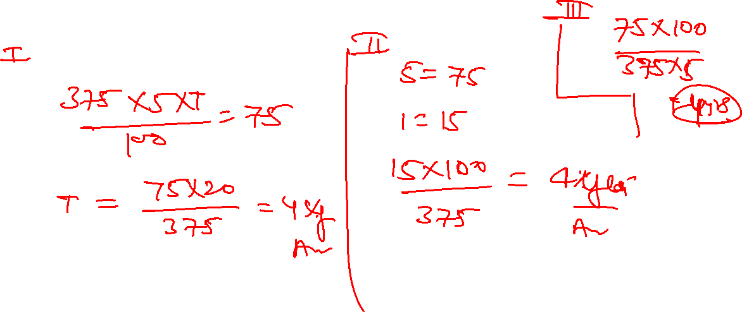
SIMPLE INTEREST
Q.6: If simple interest on 375 increases by 75, when the rate % increases by 5% per annum. Find the time.
(1) 2 years (2) 8 years (3) 4 years (4) None of these

Slide 16
SIMPLE INTEREST
Q.7: What annual instalment will discharge a debt of 4,200 due in 5 years at 10% simple interest?
700 per year (2) 350 per year (3) 750 per year
(4) 650 per year (5) None of these

Slide 17
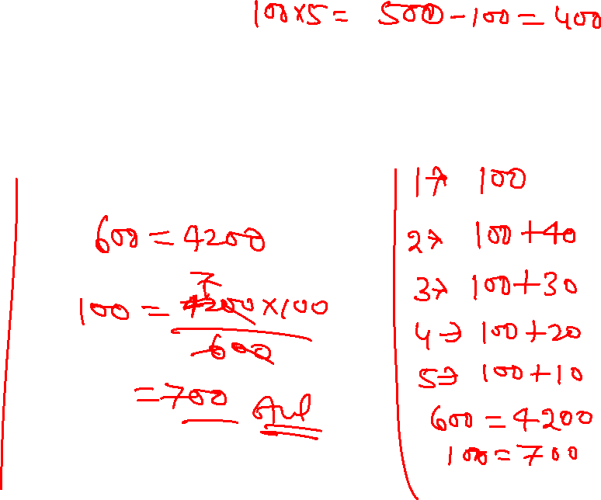
SIMPLE INTEREST
Q.7: What annual instalment will discharge a debt of 4,200 due in 5 years at 10% simple interest?
700 per year (2) 350 per year (3) 750 per year
(4) 650 per year (5) None of these

Slide 18
SIMPLE INTEREST
Q.8: Arun borrowed a sum of money from Jayant at the rate of 8% per annum simple interest for the first four years, 10% per annum for the next 6 years, and 12% per annum for the period beyond 10 years. If he pays a total of 12160 as interest only at the end of 15 years, how much money did he borrow?
(1) 8000 (2) 10000 (3) 12000 (4) 9000 (5) None of these

Slide 19
SIMPLE INTEREST
Q.8: Arun borrowed a sum of money from Jayant at the rate of 8% per annum simple interest for the first four years, 10% per annum for the next 6 years, and 12% per annum for the period beyond 10 years. If he pays a total of 12160 as interest only at the end of 15 years, how much money did he borrow?
(1) 8000 (2) 10000 (3) 12000 (4) 9000 (5) None of these

Slide 20
SIMPLE INTEREST
Q.9: In what time does a sum of money become thrice at the simple interest rate of 8% per annum?
30 years (2) 15 years (3) 20 years (4) 25 years (5) None of these

Slide 21
SIMPLE INTEREST
Q.9: In what time does a sum of money become thrice at the simple interest rate of 8% per annum?
30 years (2) 15 years (3) 20 years (4) 25 years (5) None of these

Slide 22
SIMPLE INTEREST
Q.10: A certain sum is invested for certain time. It amounts to 400 at 10% per annum. But when invested at 4% per annum, it amounts to 200. Find the time.
100 years (2) 75 years (3) 50 years (4) 60 years (5) None of these

Slide 23
SIMPLE INTEREST
Q.10: A certain sum is invested for certain time. It amounts to 400 at 10% per annum. But when invested at 4% per annum, it amounts to 200. Find the time.
100 years (2) 75 years (3) 50 years (4) 60 years (5) None of these

Slide 24
SIMPLE INTEREST
Q.11:A certain sum is invested for certain time. It amounts to 150 at 5% per annum. But when invested at 3% per annum, it amounts to 100. Find the sum.
(1) 50 (2) 25 (3) 30 (4) 60 (5) None of these

Slide 25
SIMPLE INTEREST
Q.11:A certain sum is invested for certain time. It amounts to 150 at 5% per annum. But when invested at 3% per annum, it amounts to 100. Find the sum.
(1) 50 (2) 25 (3) 30 (4) 60 (5) None of these

Slide 26
SIMPLE INTEREST
Q.12: A sum was put at SI at a certain rate for 3 years. Had it been put at 4% higher rate, it would have : fetched 600 more. Find the sum.
(1) 5000 (2) 4000 (3) 6000 (4) 3000 (5) None of these

Slide 27
SIMPLE INTEREST
Q.12: A sum was put at SI at a certain rate for 3 years. Had it been put at 4% higher rate, it would have : fetched 600 more. Find the sum.
(1) 5000 (2) 4000 (3) 6000 (4) 3000 (5) None of these

Slide 28
SIMPLE INTEREST
Q.13 A certain sum of money amounts to 550 in 3 years and to 650 in 4 years. Find the sum.
(1) 250 (2) 300 (3) 150 (4) 350 (5) None of these

Slide 29
SIMPLE INTEREST
Q.13 A certain sum of money amounts to 550 in 3 years and to 650 in 4 years. Find the sum.
(1) 250 (2) 300 (3) 150 (4) 350 (5) None of these

Slide 30
SIMPLE INTEREST
Q.14: A sum was put at SI at a certain rate for 4 years. Had it been put at 5% lower rate, it would have fetched 100 less. Find the sum.
(1) 500 (2) 5000 (3) 400 (4) 4000 (5) None of these

Slide 31
SIMPLE INTEREST
Q.14: A sum was put at SI at a certain rate for 4 years. Had it been put at 5% lower rate, it would have fetched 100 less. Find the sum.
(1) 500 (2) 5000 (3) 400 (4) 4000 (5) None of these

Slide 32
SIMPLE INTEREST
Q.15: Anish borrowed 15000 at the rate of 12% and an other amount at the rate of 15% for two years. The total interest paid by him was 9000. How much did he borrow?
(1) 32000 (2) 33000 (3) 30000 (4) 63000 (5) None of these

Slide 33
SIMPLE INTEREST
Q.15: Anish borrowed 15000 at the rate of 12% and an other amount at the rate of 15% for two years. The total interest paid by him was 9000. How much did he borrow?
(1) 32000 (2) 33000 (3) 30000 (4) 63000 (5) None of these

Slide 34
SIMPLE INTEREST
Q.16: At a certain rate of simple interest 400 amounted to 460 in 3 years. If the rate of interest be decreased by 3%, what will be the amount after 3 years?
(1) 424 (2) 484 (3) 242 (4) 848 (5) None of these

Slide 35
SIMPLE INTEREST
Q.16: At a certain rate of simple interest 400 amounted to 460 in 3 years. If the rate of interest be decreased by 3%, what will be the amount after 3 years?
(1) 424 (2) 484 (3) 242 (4) 848 (5) None of these

Slide 36
SIMPLE INTEREST
Q.17: 1,200 amounts to 1,632 in 4 years at a certain rate of simple interest. If the rate of interest is increased by 1%, it would amount to how much?
(1) 1635 (2) 1644 (3) 1670 (4) 1680 (5) None of these

Slide 37
SIMPLE INTEREST
Q.17: 1,200 amounts to 1,632 in 4 years at a certain rate of simple interest. If the rate of interest is increased by 1%, it would amount to how much?
(1) 1635 (2) 1644 (3) 1670 (4) 1680 (5) None of these

Slide 38
SIMPLE INTEREST
Q.18: The simple interest on a sum of money will be 150 after 4 years. In the next 4 years principal becomes 5 times, what will be the total interest at the end of the 8th year?
(1) 950 (2) 850 (3) 900 (4) 860 (5) None of these

Slide 39
SIMPLE INTEREST
Q.18: The simple interest on a sum of money will be 150 after 4 years. In the next 4 years principal becomes 5 times, what will be the total interest at the end of the 8th year?
(1) 950 (2) 850 (3) 900 (4) 860 (5) None of these

Slide 40
SIMPLE INTEREST
Q.19: The simple interest on a sum of money will be 225 after 3 years. In the next 5 years principal becomes 3 times, what will be the total interest at the end of the 8th year?
(1) 1250 (2) 1330 (3) 1360 (4) 1350 (5) None of these

Slide 41
SIMPLE INTEREST
Q.19: The simple interest on a sum of money will be 225 after 3 years. In the next 5 years principal becomes 3 times, what will be the total interest at the end of the 8th year?
(1) 1250 (2) 1330 (3) 1360 (4) 1350 (5) None of these

Slide 42
SIMPLE INTEREST
Q.20: A sum of 1521 is lent out in two parts in such a way that the interest on one part at 10% for 5 years is equal to that on another part at 8% for 10 years. Find the two sums.
926, 595 (2) 906, 615 (3) 916, 605 (4) 936, 585 (5) None of these

Slide 43
SIMPLE INTEREST
Q.20: A sum of 1521 is lent out in two parts in such a way that the interest on one part at 10% for 5 years is equal to that on another part at 8% for 10 years. Find the two sums.
926, 595 (2) 906, 615 (3) 916, 605 (4) 936, 585 (5) None of these

Slide 44
SIMPLE INTEREST
Q.21: A sum of money becomes two times at the simple interest rate of 2% per annum. At what rate per cent will it become five fold?
(1) 10% (2) 8% (3) 6% (4) 9% (5) None of these

Slide 45
SIMPLE INTEREST
Q.21: A sum of money becomes two times at the simple interest rate of 2% per annum. At what rate per cent will it become five fold?
(1) 10% (2) 8% (3) 6% (4) 9% (5) None of these

Slide 46
SIMPLE INTEREST
Q.22: A certain sum of money amounted to 810 at 4% in a time in which 450 amounted to 720 at 3%. If the rate of interest is simple, find the sum.
(1) 500 (2) 450 (3) 600 (4) 475 (5) None of these

Slide 47
SIMPLE INTEREST
Q.22: A certain sum of money amounted to 810 at 4% in a time in which 450 amounted to 720 at 3%. If the rate of interest is simple, find the sum.
(1) 500 (2) 450 (3) 600 (4) 475 (5) None of these

Slide 48
SIMPLE INTEREST
Q.23: A certain sum of money amounts to 5000 in 5 years at 10% per annum. In how many years will it amount to 6000 at the same rate?
8 years (2) 6 years (3) 10 years (4) 9 years (5) None of these

Slide 49
SIMPLE INTEREST
Q.23: A certain sum of money amounts to 5000 in 5 years at 10% per annum. In how many years will it amount to 6000 at the same rate?
8 years (2) 6 years (3) 10 years (4) 9 years (5) None of these

Slide 50
SIMPLE INTEREST
Q.24: 8829 is divided into three parts in such a way that their amounts at 4% per annum simple interest after 5, 6 and 8 years are equal. Find each part of the sum.
3069, 2970, 2790 (2) 3609, 2970, 2790
(3) 3089, 2970, 2790 (4) 3069, 2960, 2760
(5) None of these

Slide 51
SIMPLE INTEREST
Q.24: 8829 is divided into three parts in such a way that their amounts at 4% per annum simple interest after 5, 6 and 8 years are equal. Find each part of the sum.
3069, 2970, 2790 (2) 3609, 2970, 2790
(3) 3089, 2970, 2790 (4) 3069, 2960, 2760
(5) None of these

Slide 52
SIMPLE INTEREST
Q.25: What principal will amount to 560 in 3 years at 4 per cent per annum simple interest?
(1) 540 (2) 500 (3) 550 (4) 560 (5) None of these

Slide 53
SIMPLE INTEREST
Q.25: What principal will amount to 560 in 3 years at 4 per cent per annum simple interest?
(1) 540 (2) 500 (3) 550 (4) 560 (5) None of these

Slide 54
SIMPLE INTEREST
Q.26: A person lent a certain sum of money at 4% simple interest, and in 5 years the interest amounted to 520 less than the sum lent. Find the sum lent.
(1) 600 (2) 650 (3) 700 (4) 750 (5) None of these

Slide 55
SIMPLE INTEREST
Q.26: A person lent a certain sum of money at 4% simple interest, and in 5 years the interest amounted to 520 less than the sum lent. Find the sum lent.
(1) 600 (2) 650 (3) 700 (4) 750 (5) None of these

Slide 56
SIMPLE INTEREST
Q.27: A sum of money doubles itself in 5 years. It will become 4 times of itself in–
10 years (2) 12 years (3) 15 years (4) 20 years (5) None of these

Slide 57
SIMPLE INTEREST
Q.27: A sum of money doubles itself in 5 years. It will become 4 times of itself in–
10 years (2) 12 years (3) 15 years (4) 20 years (5) None of these

Slide 58
SIMPLE INTEREST
Q.28: The simple interest on 1250 will be less than the interest on 1400 at 3% simple interest by 45. Find the time.
10 years (2) 9 years (3) 8 years (4) 6 years (5) None of these

Slide 59
SIMPLE INTEREST
Q.28: The simple interest on 1250 will be less than the interest on 1400 at 3% simple interest by 45. Find the time.
10 years (2) 9 years (3) 8 years (4) 6 years (5) None of these

Slide 60
SIMPLE INTEREST
Q.29: The difference in simple interests on a certain sum at 4% per annum for 3 years and at 5% per annum for 2 years is 50. Find the sum.
(1) 5000 (2) 4000 (3) 3000 (4) 2500 (5) None of these

Slide 61
SIMPLE INTEREST
Q.29: The difference in simple interests on a certain sum at 4% per annum for 3 years and at 5% per annum for 2 years is 50. Find the sum.
(1) 5000 (2) 4000 (3) 3000 (4) 2500 (5) None of these

Slide 62
SIMPLE INTEREST
Q.30: The difference between the interest received from two different banks on 200 for 3 years is 60. Find the difference between their rates.
(1) 5% (2) 7% (3) 10% (4) 9% (5) None of these

Slide 63
SIMPLE INTEREST
Q.30: The difference between the interest received from two different banks on 200 for 3 years is 60. Find the difference between their rates.
(1) 5% (2) 7% (3) 10% (4) 9% (5) None of these

Slide 64
SIMPLE INTEREST
Q.31: A sum of money lent out at simple interest amounts to 720 in 2 years and to 1020 in 7 years. Find the rate per cent per annum.
(1) 10% (2) 12% (3) 5% (4) 15% (5) None of these

Slide 65
SIMPLE INTEREST
Q.31: A sum of money lent out at simple interest amounts to 720 in 2 years and to 1020 in 7 years. Find the rate per cent per annum.
(1) 10% (2) 12% (3) 5% (4) 15% (5) None of these

Slide 66
SIMPLE INTEREST
Q.32: Sudhir borrows 6000 from a bank at SI. After 4 years he paid 2500 to the bank and at the end of 5 years from the date of borrowing he paid 4560 to the bank to settle the account. Find the rate of interest.
(1) 3% (2) 3.5% (3) 3.85% (4) 4.5% (5) None of these

Slide 67
SIMPLE INTEREST
Q.32: Sudhir borrows 6000 from a bank at SI. After 4 years he paid 2500 to the bank and at the end of 5 years from the date of borrowing he paid 4560 to the bank to settle the account. Find the rate of interest.
(1) 3% (2) 3.5% (3) 3.85% (4) 4.5% (5) None of these

Slide 68
SIMPLE INTEREST
Q.33: Some amount out of 950 was lent at 6% per annum and the remaining at 4% per annum. If the total simple interest from both the fractions in 5 years was 200, find the sum lent at 6% per annum.
(1) 700 (2) 100 (3) 250 (4) 450 (5) None of these

Slide 69
SIMPLE INTEREST
Q.33: Some amount out of 950 was lent at 6% per annum and the remaining at 4% per annum. If the total simple interest from both the fractions in 5 years was 200, find the sum lent at 6% per annum.
(1) 700 (2) 100 (3) 250 (4) 450 (5) None of these

Slide 70
SIMPLE INTEREST
Q.34 Out of a certain sum, 1/3rd is invested at 3%, 1/6th at 6% and the rest at 8%. If the simple interest for 2 years from all these investments amounts to 600, find the original sum.
(1) 5000 (2) 6000 (3) 5200 (4) 5500 (5) None of these

Slide 71
SIMPLE INTEREST
Q.34. Out of a certain sum, 1/3rd is invested at 3%, 1/6th at 6% and the rest at 8%. If the simple interest for 2 years from all these investments amounts to 600, find the original sum.
(1) 5000 (2) 6000 (3) 5200 (4) 5500 (5) None of these

Slide 72
SIMPLE INTEREST
Q.35: The simple interest on certain sum 625 is 100, and the number of years is equal to the rate per cent per annum. Find the rate per cent.
(1) 5% (2) 4% (3) 3% (4) 4.5% (5) None of these

Slide 73
SIMPLE INTEREST
Q.35: The simple interest on certain sum 625 is 100, and the number of years is equal to the rate per cent per annum. Find the rate per cent.
(1) 5% (2) 4% (3) 3% (4) 4.5% (5) None of these

Slide 74
SIMPLE INTEREST
Q.36: A certain sum of money is borrowed by a person at 3% simple interest for 4 years. If he has to pay 120 as interest, find the total amount he has to pay.
(1) 1020 (2) 820 (3) 1120 (4) 1220 (5) None of these

Slide 75
SIMPLE INTEREST
Q.36: A certain sum of money is borrowed by a person at 3% simple interest for 4 years. If he has to pay 120 as interest, find the total amount he has to pay.
(1) 1020 (2) 820 (3) 1120 (4) 1220 (5) None of these

Slide 76
SIMPLE INTEREST
Q.37: The simple interest on 400 for 5 years together with that on 600 for 4 years came to 132, the rate being the same in both the cases. Find the rate per cent of interest.
(1) 1% (2) 5% (3) 4% (4) 3% (5) None of these

Slide 77
SIMPLE INTEREST
Q.37: The simple interest on 400 for 5 years together with that on 600 for 4 years came to 132, the rate being the same in both the cases. Find the rate per cent of interest.
(1) 1% (2) 5% (3) 4% (4) 3% (5) None of these

Slide 78
SIMPLE INTEREST
Q.38: On 3000 invested at a simple interest rate 6 per cent per annum, 900 is obtained as interest in certain years. In order to earn 1600 as interest on 4000 in the same number of years, what should be the rate of simple interest?
7 per cent (2) 8 per cent (3) 9 per cent (4) Data inadequate
(5) None of these

Slide 79
SIMPLE INTEREST
Q.38: On 3000 invested at a simple interest rate 6 per cent per annum, 900 is obtained as interest in certain years. In order to earn 1600 as interest on 4000 in the same number of years, what should be the rate of simple interest?
7 per cent (2) 8 per cent (3) 9 per cent (4) Data inadequate
(5) None of these

Slide 80
SIMPLE INTEREST
Q.39: At what rate of interest per annum will a sum double itself in 8 years?
(1) 12½% (2) 5% (3) 6% (4) 10½% (5) None of these

Slide 81
SIMPLE INTEREST
Q.39: At what rate of interest per annum will a sum double itself in 8 years?
(1) 12½% (2) 5% (3) 6% (4) 10½% (5) None of these

Slide 82
SIMPLE INTEREST
Q.40: If x is the simple interest on y and y is the simple interest on z, the rate % and the time being the same in both cases, what is the relation between x, y and z?
X^2 = yz (2) y^2 = xz (3) z^2 = xy (4) xyz = 1
(5) None of these

Slide 83
SIMPLE INTEREST
Q.40: If x is the simple interest on y and y is the simple interest on z, the rate % and the time being the same in both cases, what is the relation between x, y and z?
X^2 = yz (2) y^2 = xz (3) z^2 = xy (4) xyz = 1
(5) None of these

Slide 84
SIMPLE INTEREST
Q.41: MRP of a refrigerator is Rs.4500. After a down payment of Rs.1100, Aparna give 5 instalments of Rs.700 each per month. Find the rate.
10% (2) 15% (3) 12% (4) 20%

Slide 85
SIMPLE INTEREST
Q.41: MRP of a refrigerator is Rs.4500. After a down payment of Rs.1100, Aparna give 5 instalments of Rs.700 each per month. Find the rate.
10% (2) 15% (3) 12% (4) 20%

Slide 86
SIMPLE INTEREST
Q.42: A sum of Rs.10 is lent to be returned in 11 monthly instalments of Rs.1 each. Interest being simple. The rate of interest will be?
70/3% (2) 80/3% (3) 20/3% (4) None of these

Slide 87
SIMPLE INTEREST
Q.42: A sum of Rs.10 is lent to be returned in 11 monthly instalments of Rs.1 each. Interest being simple. The rate of interest will be?
70/3% (2) 80/3% (3) 20/3% (4) None of these

Slide 88
SIMPLE INTEREST
Q.43: Harsh took a loan of RS.6450 and return this sum at 5% rate in 4 equal instalments at SI. Find each instalment.
(1) 1500 (2) 2000 (3) 2500 (4) 3000

Slide 89
SIMPLE INTEREST
Q.43: Harsh took a loan of RS.6450 and return this sum at 5% rate in 4 equal instalments at SI. Find each instalment.
(1) 1500 (2) 2000 (3) 2500 (4) 3000

Slide 90
SIMPLE INTEREST
Q.44: A due amount of Rs.2145 is to be given back at 25% SI in 4 months. Find monthly instalment.
(1) 300 (2) 350 (3) 390 (4) 410

Slide 91
SIMPLE INTEREST
Q.44: A due amount of Rs.2145 is to be given back at 25% SI in 4 months. Find monthly instalment.
(1) 300 (2) 350 (3) 390 (4) 410

Slide 92
SIMPLE INTEREST
Q.45: What equal annual instalment will discharge a debt of Rs.2985 due in 6 years at 10% simple interest.
(1) 324 (2) 355 (3) 380 (4) 398

Slide 93
SIMPLE INTEREST
Q.45: What equal annual instalment will discharge a debt of Rs.2985 due in 6 years at 10% simple interest.
(1) 324 (2) 355 (3) 380 (4) 398

Slide 94
SIMPLE INTEREST
Q.46: A sum of Rs. 17,200 is lent out at simple interest in two parts for 2 years at 8% p.a. _and_10% p.a., respectively. If the total interest received after 2 years is Rs.3,008, then the money lent (in Rs.) at the rate of 8% p.a. is:
(1) 10800 (2) 11000 (3) 12000 (4) 12500

Slide 95
SIMPLE INTEREST
Q.46: A sum of Rs. 17,200 is lent out at simple interest in two parts for 2 years at 8% p.a. _and_10% p.a., respectively. If the total interest received after 2 years is Rs.3,008, then the money lent (in Rs.) at the rate of 8% p.a. is:
(1) 10800 (2) 11000 (3) 12000 (4) 12500

Slide 96
SIMPLE INTEREST
Q.47: A sum of ₹ 15,600 is invested partly at 7% per annum and the remaining at 9% per annum simple interest. If the total interest at the end of 3 years is ₹3738, how much money was invested at 7% per annum ?
(1) 7700 (2) 7800 (3) 7900 (4) 8000

Slide 97
SIMPLE INTEREST
Q.47: A sum of ₹ 15,600 is invested partly at 7% per annum and the remaining at 9% per annum simple interest. If the total interest at the end of 3 years is ₹3738, how much money was invested at 7% per annum ?
(1) 7700 (2) 7800 (3) 7900 (4) 8000

Slide 98
SIMPLE INTEREST
Q.48: A sum of 10,200 is invested partly at 8% per annum and remaining at 6% per annum for 3 years at simple interest. If the total interest is 2,124, how much money was invested at 6% per annum?
(1) 5400 (2) 5500 (3) 5700 (4) 5800

Slide 99
SIMPLE INTEREST
Q.48: A sum of 10,200 is invested partly at 8% per annum and remaining at 6% per annum for 3 years at simple interest. If the total interest is 2,124, how much money was invested at 6% per annum?
(1) 5400 (2) 5500 (3) 5700 (4) 5800

Slide 100
SIMPLE INTEREST
Q.49: A person lends 40% of his sum of money at 15% per annum, 50% of rest at 10% per annum and the rest at 18% per annum rate of interest, if the interest is calculated on the whole sum then what would be the annual rate of interest?
(1) 10% (2) 12% (3) 14.4% (4) 15.1%

Slide 101
SIMPLE INTEREST
Q.49: A person lends 40% of his sum of money at 15% per annum, 50% of rest at 10% per annum and the rest at 18% per annum rate of interest, if the interest is calculated on the whole sum then what would be the annual rate of interest?
(1) 10% (2) 12% (3) 14.4% (4) 15.1%

Slide 102
SIMPLE INTEREST
Q.50: A person invested one-fourth of the sum of ₹25,000 at a certain rate of simple interest and the rest at 4% p.a. higher rate. If the total interest received for 2 years is ₹4,125. What is the rate at which the second sum was invested?
(1) 9% (2) 9.25% (3) 9.5% (4) 10%

Slide 103
SIMPLE INTEREST
Q.50: A person invested one-fourth of the sum of ₹25,000 at a certain rate of simple interest and the rest at 4% p.a. higher rate. If the total interest received for 2 years is ₹4,125. What is the rate at which the second sum was invested?
(1) 9% (2) 9.25% (3) 9.5% (4) 10%

Slide 104
SIMPLE INTEREST
Q.51: If the amount obtained by A by investing Rs 9,100 for three years at a rate of 10% p.a. on simple interest is equal to the amount obtained by B by investing a certain sum of money for five years at a rate of 8% p.a. on simple interest, then 90% of the sum invested by B ( in Rs) is:
(1) 6000 (2) 6142.5 (3) 6300.5 (4) 6400.5

Slide 105
SIMPLE INTEREST
Q.51: If the amount obtained by A by investing Rs 9,100 for three years at a rate of 10% p.a. on simple interest is equal to the amount obtained by B by investing a certain sum of money for five years at a rate of 8% p.a. on simple interest, then 90% of the sum invested by B ( in Rs) is:
(1) 6000 (2) 6142.5 (3) 6300.5 (4) 6400.5

Slide 106
SIMPLE INTEREST
Q.52: ₹21750 is invested by a person in the bank account of his two sons whose ages are 9 years and 13 years in such a way that they will get equal amount at an age of 21 years at the rate of 4.5% per annum. Find the share of younger child.
(1) 10200 (2) 11550 (3) 12000 (4) 12200

Slide 107
SIMPLE INTEREST
Q.52: ₹21750 is invested by a person in the bank account of his two sons whose ages are 9 years and 13 years in such a way that they will get equal amount at an age of 21 years at the rate of 4.5% per annum. Find the share of younger child.
(1) 10200 (2) 11550 (3) 12000 (4) 12200

Slide 108
THANK YOU

